Slide 1
Magician’s Image Caption
Jack Yu Jiahao Guo Yiqun Fan

Slide 2
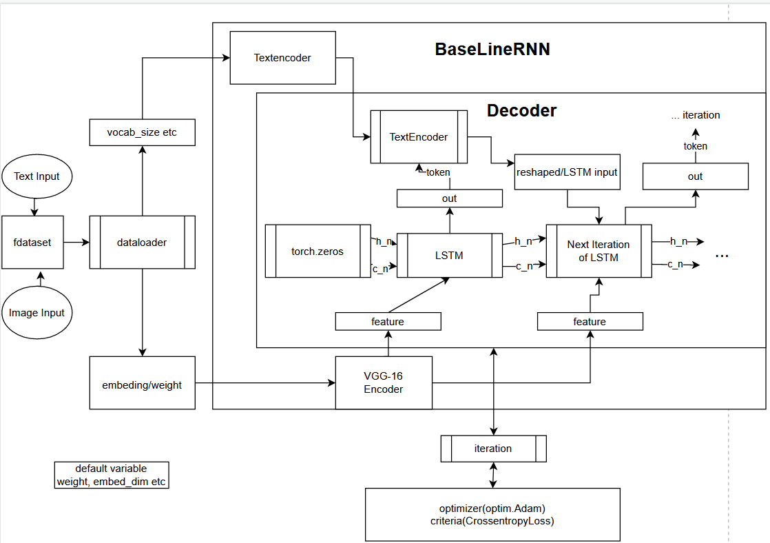
At first we will use Fdataset to process the image and text.
Later the exist data will be split and load into 2 set
Dataloader will extract the variable we need
Such as embedding or weight for VGG and vocab size for textencoder
The BaseLineRNN is our model, as the base-
-line established, a VGG-16 image encoder a-
-nd a Textencoder will be initiated with the
Variable we gather from dataloader or design
By ourself.
When the training start, the LSTM will gather
feature from image encoder and h_n and c_n
generate from torch. Later the LSTM model
will generate out result which the textencod-
-er will gather token and reshaped to the inp-
-ut for next iteration of LSTM, and the next
Iteration will received feature from new iter-
Ation of image encoder as well.
During the iteration, the optimizer and criteria wi-
-ll record the lose for further training.

Slide 3
Result
We don’t have a result at this moment
due to the high capacity of our dataset, it would be difficult to gather result from short train.
We are working on reduce the time cost of training but it would still take long time due to the capacity.

Slide 4

Lesson Learned so far
Challenge
1: Image Caption is hard
2: The time cost for each epochs of train is heavy
and we have a huge dataset to train and test
Lesson
1: the local machine might not have a good performance on
maga-data
2: A minor result but fast epochs should be consider as an
suitable way when dealing with maga-dataset.

Slide 5
Conclusion and future
What we got so far?
What we do next?
Improve the cost efficiency of our training process.
As the base structure goes to stable, we will introduce new dataset (COCO) to increase our performance
New module such as attention module will be put into consideration.

